Slide 1

Python in Mantid

Slide 2
Python Basics
Variable assignment in Python is simpler than in other languages as you do not specify types
  x = 5; x += 1; x = ‘a string’
Some operations are not possible with certain types
  ‘a string’ + 5 → TypeError: cannot concatenate 'str' and 'int' objects
  Wrap 5 with str() to add them

Slide 3
Python Basics
Python uses indentation instead of brackets to separate code blocks
  for i in range(0, 5):
    print i
  fibs = [1,1,2,3,5]
  for i in fibs:
    print i

Slide 4
Executing Algorithms
Each Mantid algorithm has a corresponding Python function of the same name
The arguments of the function are the parameters of the algorithm
Execute the algorithm by simply calling the function
  LoadRaw('path-to-file','Result')

Slide 5
Executing Algorithms
mantidHelp() gives a list of the algorithms currently available
mantidHelp(“algorithm-name”) shows help for the named algorithm
  Usage: LoadRaw(Filename, OutputWorkspace, spectrummin, spectrummax, spectrumlist, Cache)
  Name: Filename, Optional: No, Direction: Input, Allowed values: raw, sav, s[0-9][0-9]
  Name: OutputWorkspace, Optional: No, Direction: Output
  Name: spectrummin, Optional: Yes, Default value: 1, Direction: Input
  Name: spectrummax, Optional: Yes, Default value: 2147483632, Direction: Input
  Name: spectrumlist, Optional: Yes, Default value: , Direction: Input Name: Cache, Optional: Yes, Default value: If slow, Direction: Input, Allowed values: Always, If slow, Never

Slide 6
Combining Python and Mantid
Use Python to automate tasks
  rootdir = 'C:/MantidInstall/Data/'
  prefix = 'LOQ‘
  run_nums = [48098,48094,48130,48128]
  for run in run_nums:
  LoadRaw(rootdir + prefix + str(run) + '.raw', str(run))
Functions are useful when a set of operations is to be applied frequently

Slide 7
Using functions
def LoadAndConvert(filepath, output_workspace, final_unit): LoadRaw(filepath, output_workspace) ConvertUnits(output_workspace, output_workspace, final_unit)
rootdir = 'C:/MantidInstall/Data/'
prefix = 'LOQ'
run_nums = [48098,48094,48130,48128]
for run in run_nums:
LoadAndConvert(rootdir + prefix + str(run) + '.raw', str(run), 'dSpacing')
If an output workspace as the same name as an input, the input is overwritten

Slide 8
Exercise One
The HRPD data contains a spike every 20 milliseconds. While this is nicely localized in time-of-flight, it is not the case upon conversion to d-spacing. The aim of this exercise is to use Mantid to exclude the contribution from the pulse.
Steps:
  Load HRPD data
  Use MaskBins algorithm to apply a mask to the bins corresponding to pulse
  Focus the data by
    First adjusting the bin positions using the AlignDetectors algorithm and
    Second use DiffractionFocussing to focus the data into groups specified by the cal file.

Slide 9
Script Generation
Every workspace created by an algorithm has a history associated with it
The history stores all of the information regarding the creation of the specified workspace, i.e. algorithms and property information.
This information can be used to generate a script to rerun the algorithms that created that workspace.

Slide 10
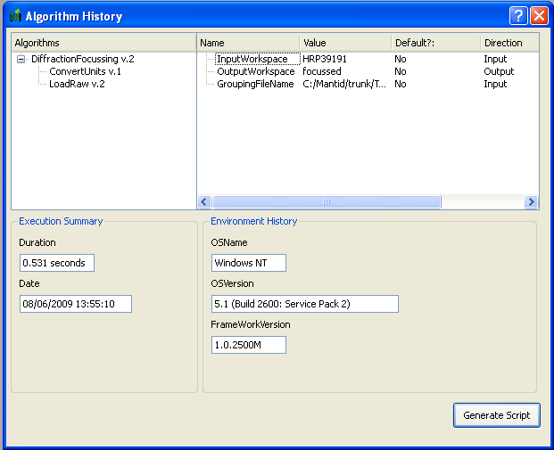
Script Generation
To view the history of a workspace in MantidPlot, right click on the entry within the Mantid Workspaces box and select Show History.

Slide 11
Generalising scripts
The script generated from the history window will be specific to the properties contained within it.
A more useful script will be able to handle different parameters with each run
Algorithm dialog boxes can be used from Python to ask for user input

Slide 12
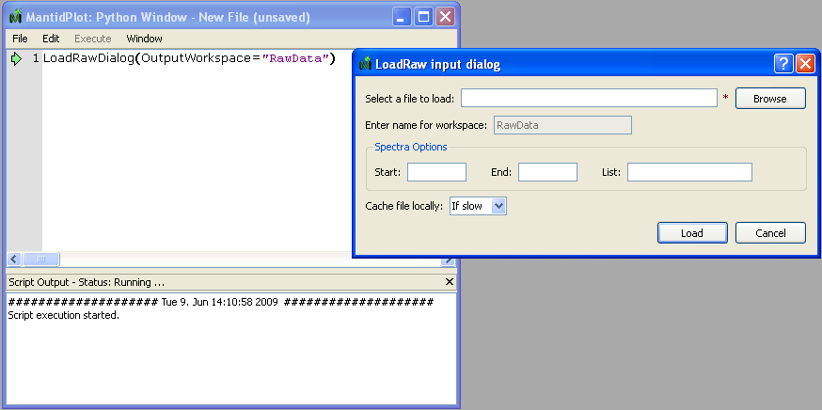
Generalising scripts
Every algorithm function also has a counterpart with the word ‘Dialog’ appended to it

Slide 13
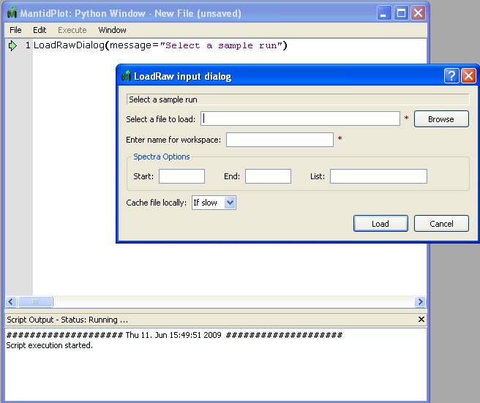
Generalising scripts
Suggested values are specified by prefixing the value with a ‘?’
Each dialog has an optional message parameter e.g.

Slide 14
Extracting property values
After an algorithm has been executed the properties remain available to access
Each function that runs an algorithm returns a handle to it. Use getPropertyValue on it to find the value
  alg = LoadRawDialog(OutputWorkspace=“test”)
  filename = alg.getPropertyValue(“Filename”)

Slide 15
Exercise 2
The aim of this exercise is to create a general script that can accept user interaction to alter the parameters for future uses
See here for a set of suggested steps to perform

Slide 16
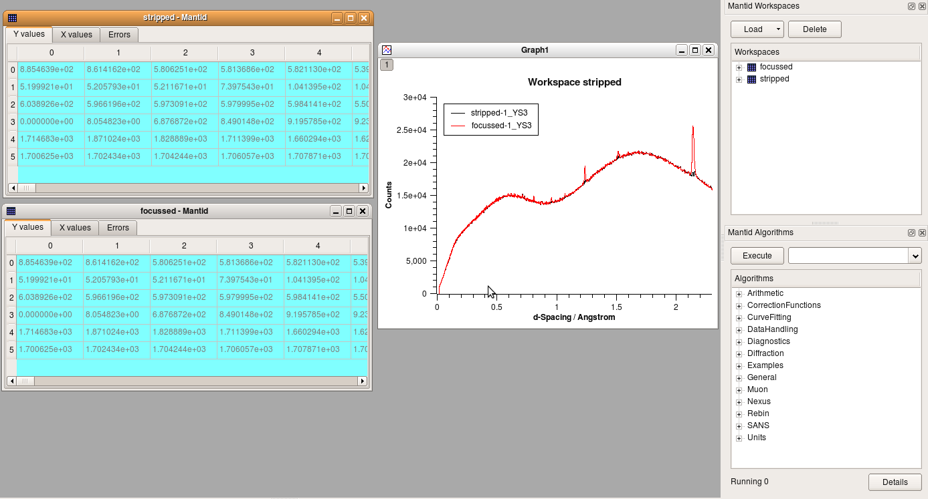
MantidPlot
MantidPlot is used to create tables and graphs of the data produced with Mantid
This can also be automated with Python

Slide 17
MantidPlot Control
To display a matrix of values use importMatrixWorkspace(“workspace-name”)
Interaction with graphs is through
  gs = plotSpectrum(‘workspace-name’, index)
  gt = plotTimeBin(‘workspace-name’,index)
To combine 2 plots use mergePlots()
  mergePlots(gs, plotSpectrum(“name”, 1))

Slide 18
Plot Properties
Various aspects of the plot display can be controlled, e.g.
  # Get the active layer of the the graph
  l = gs.activeLayer()
  # Rescale the x-axis to a show a smaller region l.setAxisScale(Layer.Bottom, 2.0, 2.5)
  # Retitle the y-axis
  l.setAxisTitle(Layer.Left, "Cross-section")
  # Put y-axis on a log scale
  l.setAxisScale(Layer.Left, 1, 1000, Layer.Log10)
  # Change the title of a curve
  l.setCurveTitle(0, "My Title")

Slide 19
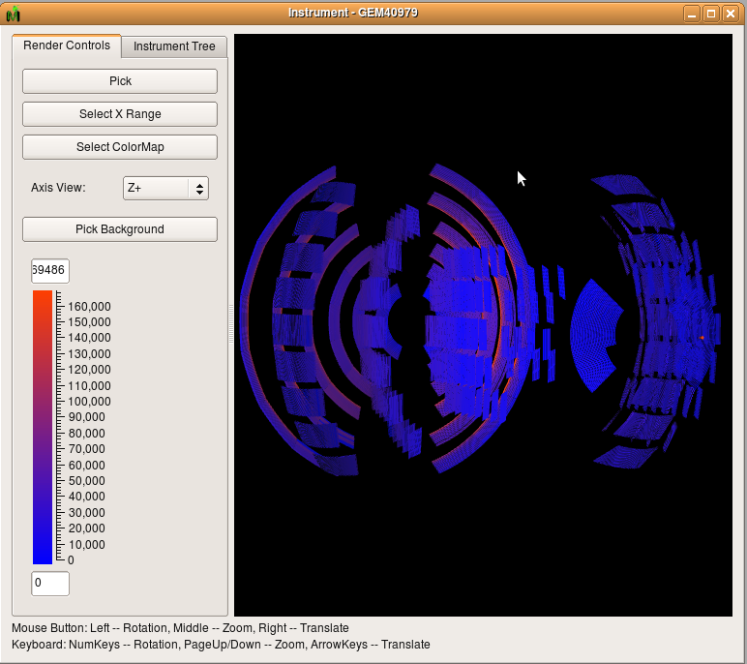
Instrument Window
The instrument view window renders the instrument in 3D

Slide 20
Instrument Window
In a script you can set properties of the window before it is raised
  instrument_window = getInstrumentView(“ws-name")
  instrument_window.setColorMapRange(0., 200.)
  instrument_window.setColorMap(“path-to-file”)
  instrument_window.showWindow()
  # Or select a component by name
  instrument_window.selectComponent(“name”)
  instrument_window.showWindow()

Slide 21
Exercise 3
Graphing
  Load bank 2 of GEM, spectrum 451 -> 750
  Convert units to dSpacing
  Smooth the data using SmoothData
  Plot workspace index 0
  Merge the plot from index 1 with the first graph created
  Merge index 2 with the first graph also
  Rescale x-axis to range to 4 < x < 6
  Rescale y-axis to range to 0 < x < 15
Instrument view
  Load LOQ48097 data set
  Get the instrument view
  Change the colour map to _standard.map (All of the colourmap files can be found in C:\MantidInstall\colormaps)
  Set the colour map range to (0,195)
  Show the window

Slide 22
Command Line
MantidPlot is just one way of ‘driving’ Mantid
Mantid can also be used from within a Python interpreter on the command line in one of two ways:
  Interactive mode: Each line of code executes as you press enter
  Script mode: Python executes a script from a separately written file

Slide 23
Command Line
Either mode requires using the MantidScript.bat file
For interactive mode:
  Change to C:\MantidInstall\bin
  Run MantidScript.bat --> This starts Python with Mantid embedded within it
For script mode:
  Change to C:\MantidInstall\bin
  Run MantidScript.bat name-of-script.py --> This runs the named script and then exits Python
As the script executes, output messages will appear on the command line

Slide 24
Accessing workspaces
To list the available workspaces use the command mantid.getWorkspaceNames()
A handle to the workspace is retrieved by using
  wksp = mantid.getMatrixWorkspace(‘name’)
To access the values within the workspace use readX(), readY() and readE()
  # gives a list of values from the first spectrum in the workspace
  ydata = wksp.readY(0)

Slide 25
Accessing workspaces
Once extracted the list can be used like a python list
  for i in ydata:
    print i
The number of histograms within the workspace is given by mantid.getNumberHistograms()
To delete a workspace use mantid.deleteWorkspace(‘name’)

Slide 26
Accessing workspaces
Some algorithms produce a different type of workspace → TableWorkspace (E.g. FindPeaks)
These workspaces are set out with column names and values

Slide 27
Accessing workspaces
To access them use
  t_wksp = mantid.getTableworkspace(‘name’)
Methods to get the data such as
  t_wksp.getRowCount()
  t_wksp.getColumnCount()
  t_wksp.getColumnNames()
  t_wksp.getInteger(‘title’, index)
  t_wksp.getDouble(‘title’, index)
  t_wksp.getString(‘title’, index)

Slide 28
Instrument Interaction
The geometry of the instrument can also be accessed through the workspace.
To access the sample or the source we must go through the instrument, .e.g.
  instrument = a_workspace.getInstrument()
  sample = a_workspace.getInstrument().getSample()
  source = a_workspace.getInstrument().getSource() sample_pos = sample.getPos()
Positions are 3D vectors e.g.
  print sample_pos → [0,0,0]

Slide 29
Instrument Interaction
Vectors have the usual arithmetic operations defined on them
  # Relative vector between source and sample
  relative_pos = sample.getPos() - source.getPos()
A particular detector associated with a histogram within the workspace is found by getDetector(index)
detector = a_workspace.getDetector(0)
r = detector.getDistance(sample)
beamPos = samplePos - source.getPos()
PI = 3.1415926535
twoTheta = detector.getTwoTheta(samplePos, beamPos)*180.0/PI
phi = detector.getPhi()*180.0/PI

Slide 30


